Slide 1
Identifying Spatial Patterns on Choropleth Maps: A Comparison between humans and deep learning models
Survey Experiment Instruction (Tentative)

Slide 2
Introduction: What's included here
Slides included here represent an overview of the survey.
Each experiment contains five sections:
Informed consent page
Survey experiment instruction
Background information
Questions for maps
Completion code
We will introduce the contents in background information, questions for maps, and completion code in this instruction.

Slide 3
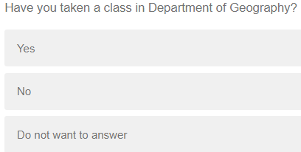
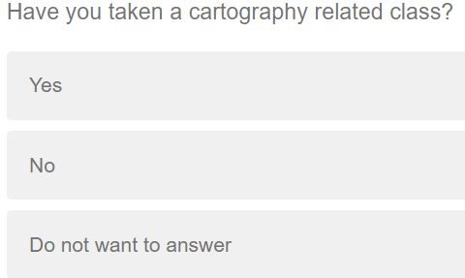
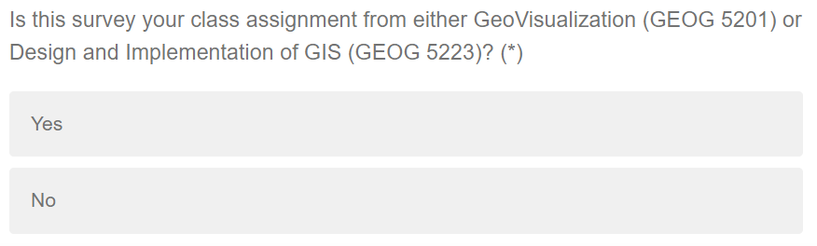
Background information
The participants will be asked three questions about their educational background in geography and cartography and about whether the survey is a class assignment.

Slide 4
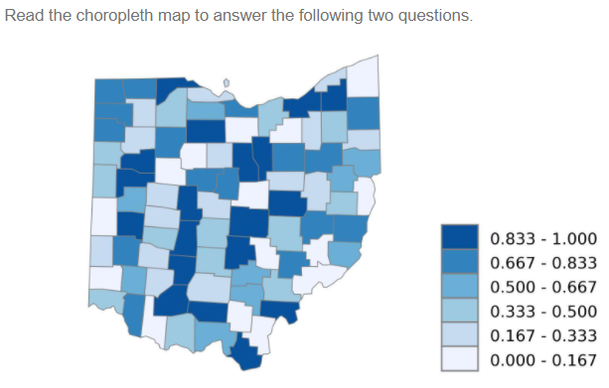
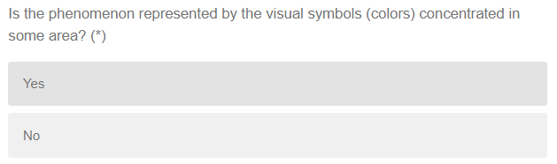
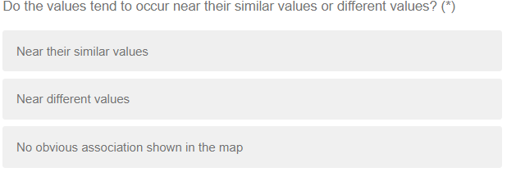
Questions for maps
Participants will be presented two questions for one map in one page.
There are totally 16 maps and 32 questions in 16 pages.
Participants must answer the two questions for one map before continuing to the next page with the next map and questions.
Notes:
Five map examples

Slide 5
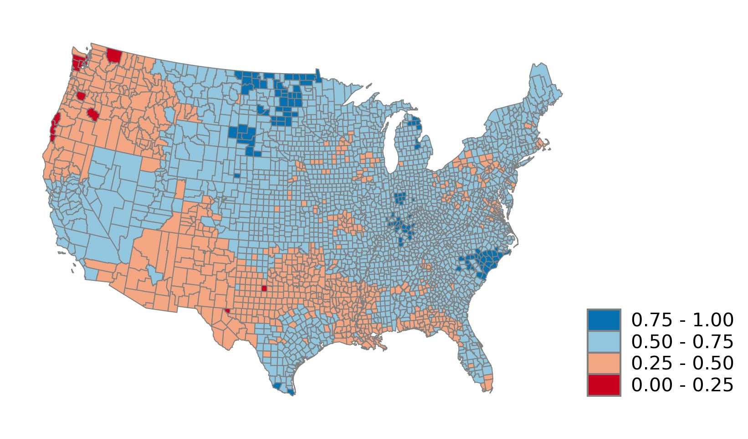
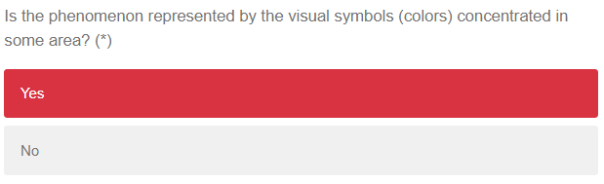
Example answers
The same colors rendering U.S. counties are concentrated in some area.
For example, the light red color is concentrated in the north west and south of the conterminous U.S.
Notes:
Five map examples

Slide 6
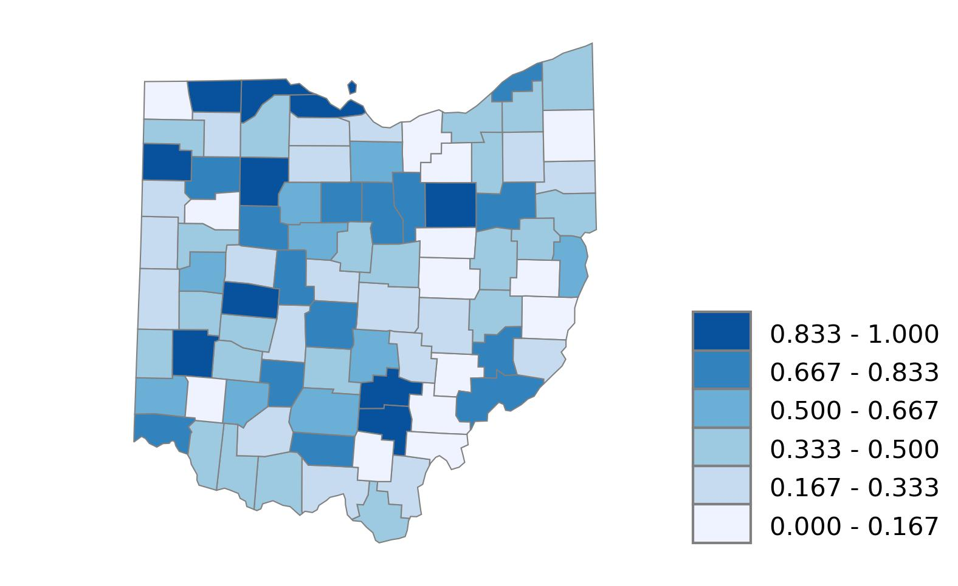
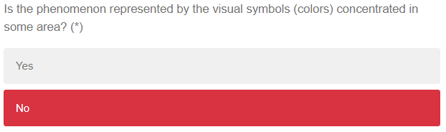
Example answers
The color for each class scatters over Ohio.
There is no significant concentration in this map.
Notes:
Five map examples

Slide 7
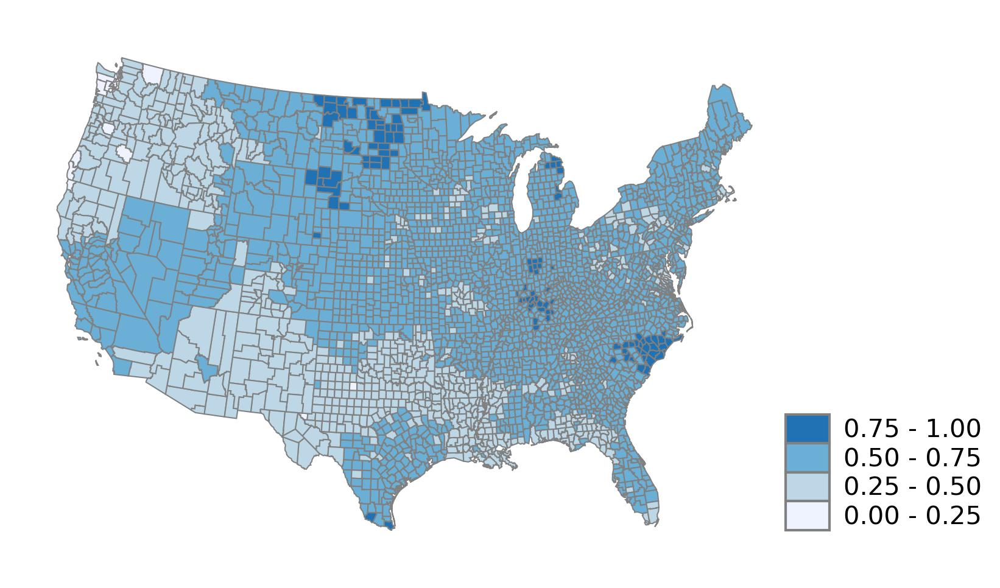
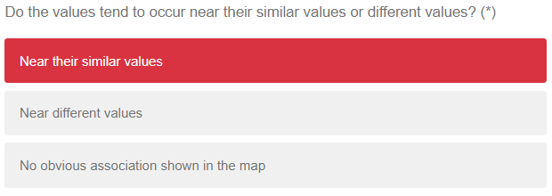
Example answers
The same colors rendering U.S. counties occur near their similar values such as the light blue color in the north west and south of the conterminous U.S.
Notes:
Five map examples

Slide 8
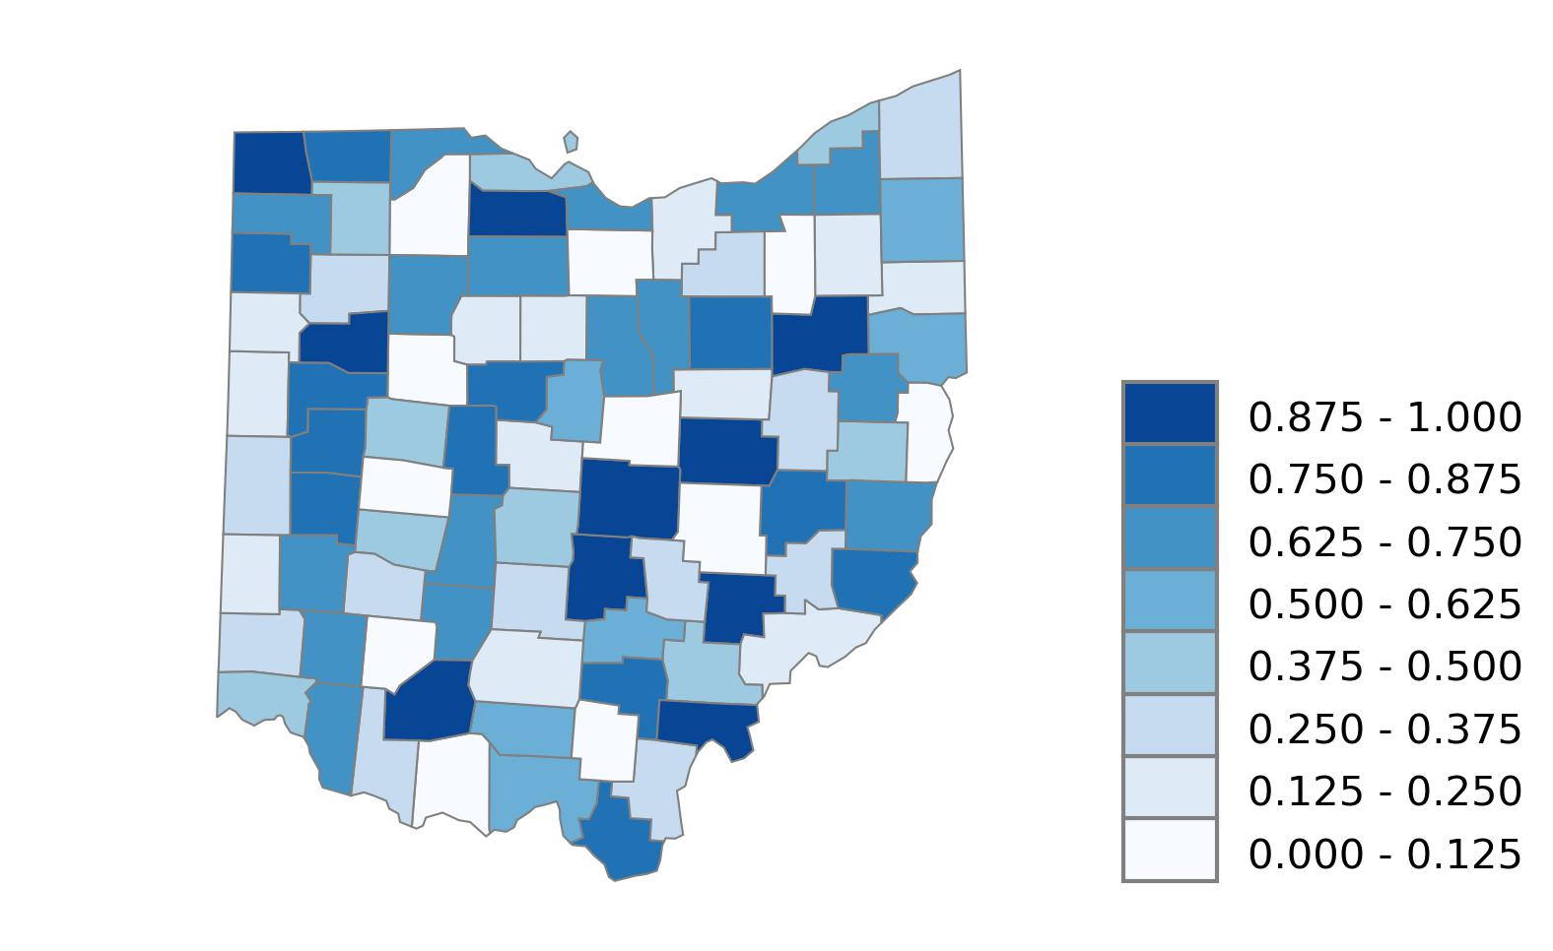
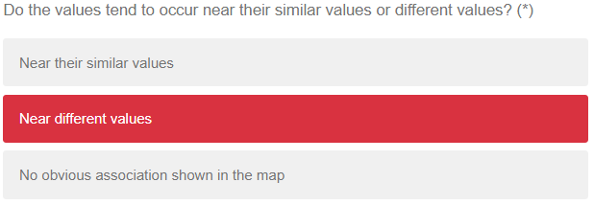
Example answers
The values occur near different values.
For example, the surrounding counties of Morgan county (red box in the map) are small values while Morgan county is rendered with a high value.
Notes:
Five map examples

Slide 9
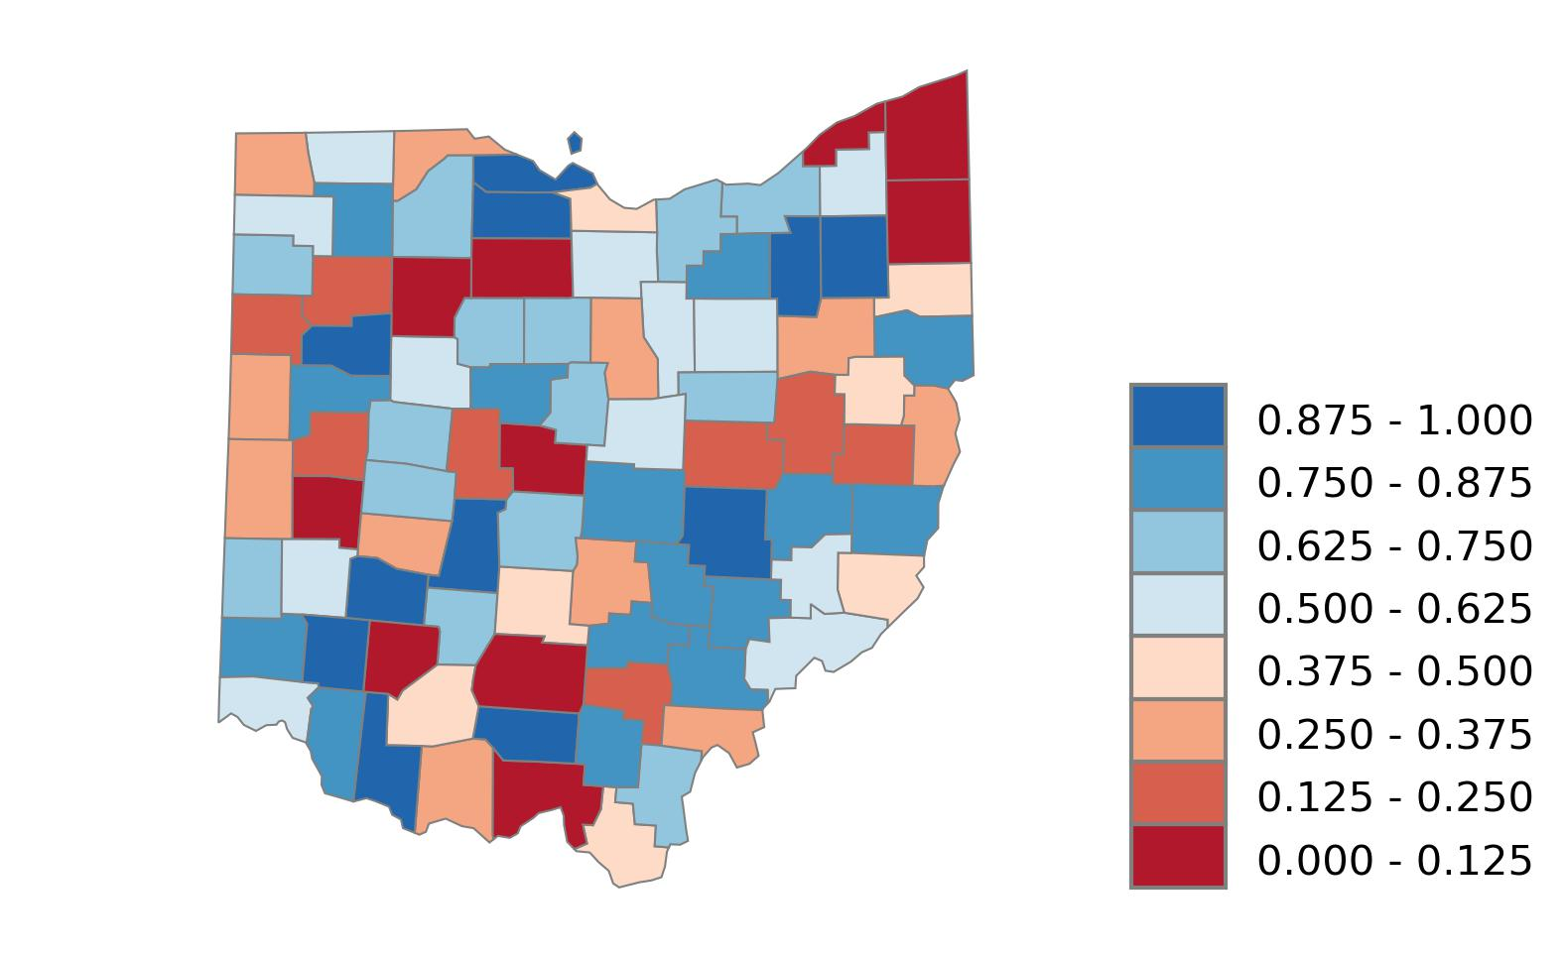
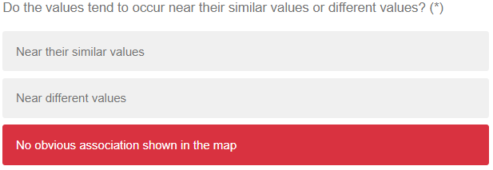
Example answers
There is no obvious association shown in the map.
The surrounding counties of most counties include both high values and low values
Notes:
Five map examples

Slide 10

Completion code
If the participant is a student in the geography classes, GEOG 5201 or GEOG 5223, there will be a completion code generated randomly at last.
The completion code will be copied and submited in his or her Carmen system, serving as the proof of completion of extra homework.

